Slide 1
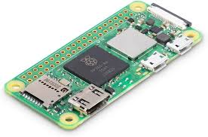
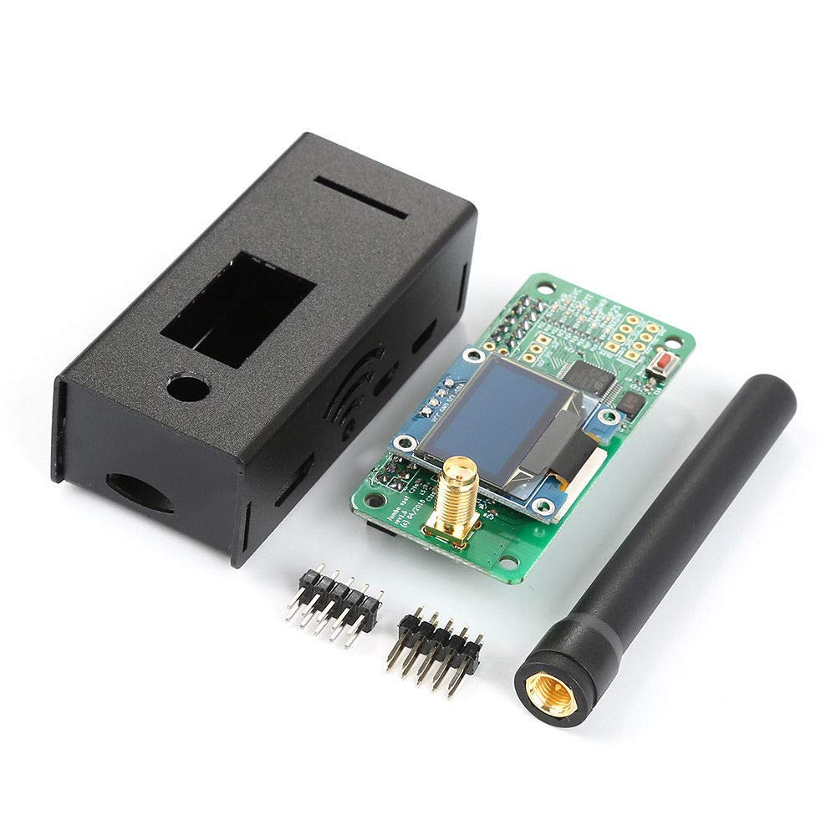
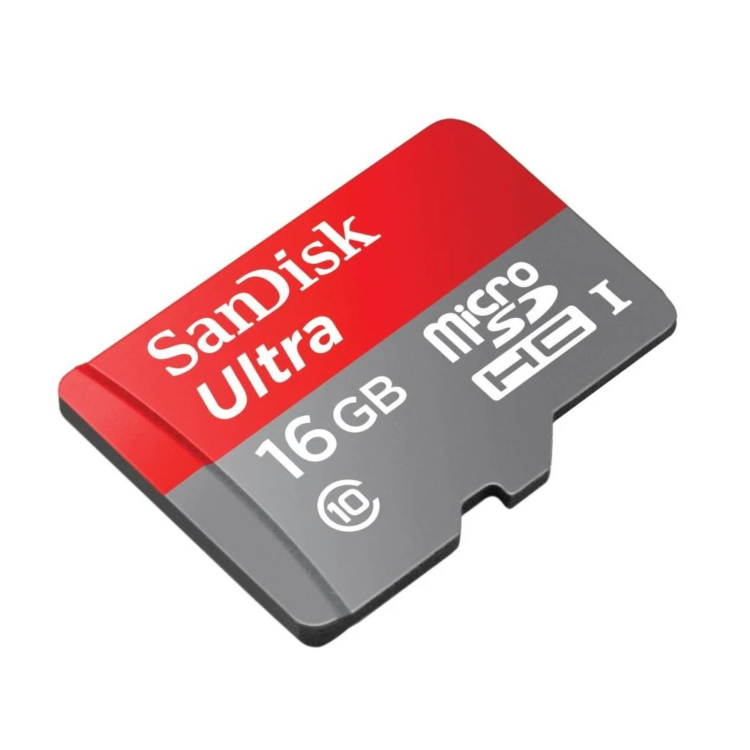
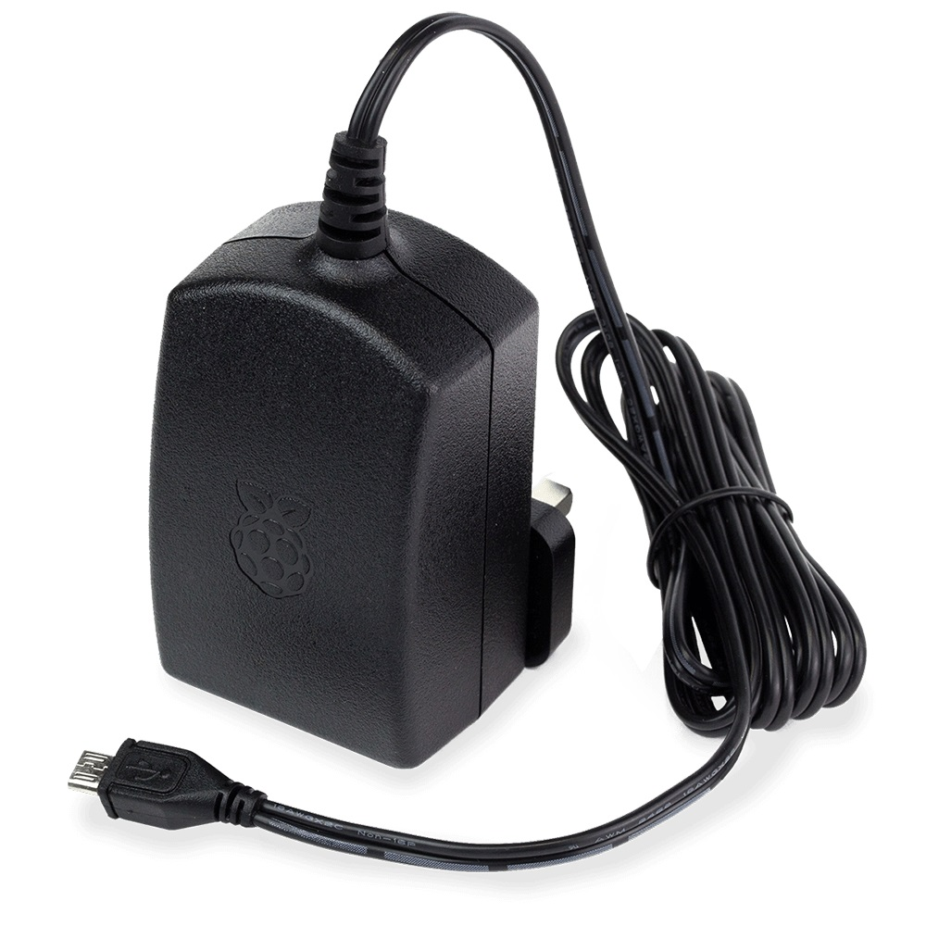
MMDVM Hotspot Build
Antony M7FGZ

Slide 2
Parts List
1 x MMDVM Hat and Case - https://s.click.aliexpress.com/e/_EGvwEFH
1 x Raspberry Pi Zero 2W - https://amzn.to/3x01N1B (Speak to me about CPC)
1 x Micro SD Card - Recommend 16GB+ - https://amzn.to/3wWPlQ6
1 x Radio Supporting a Digital Mode
1 x Micro USB Power Supply minimum 2 Amps
Above links are affiliate. Earnings from these are donated to Alder Hey Children’s hospital.

Slide 3
Tools List
1 x Soldering Iron Station and Accessories
1 x Solder wire
1 x Computer - Windows, MacOS, or Linux
1 x SD Card Reader (if not natively supported by computer)

Slide 4
Sites to Register on
DMR Id - https://radioid.net/
NXDN Id - https://radioid.net/
POCSAG Id - https://hampager.de
D-Star Registration - https://regist.dstargateway.org/Dstar.do
BrandMeister DMR Network - https://brandmeister.network/
TGIF DMR Network - https://tgif.network/

Slide 5
Software Downloads
WPSD - https://w0chp.radio/wpsd/
Raspberry Pi Imager - https://www.raspberrypi.com/software/
PuTTY (Windows Users Only) - https://www.chiark.greenend.org.uk/~sgtatham/putty/latest.html

Slide 6

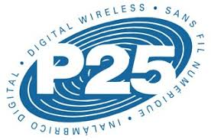

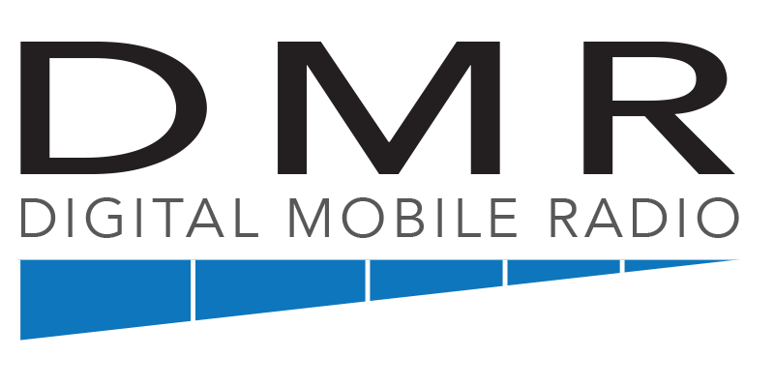



What Can I do?

Slide 7
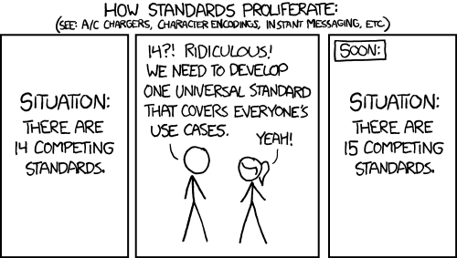
Why so many different digital modes?
https://xkcd.com/927/

Slide 8


What is D-Star?
D-STAR is a digital voice and data protocol specification for amateur radio. The system was developed in the late 1990s by the Japan Amateur Radio League and uses minimum-shift keying in its packet-based standard.
You can use your radio to connect with a local D-STAR enabled repeater or hotspot and then use it to link to Reflector and talk to people elsewhere in the world. Lots of Reflectors exist, and then there is the Mega Reflector REF001 C. Which is designed to be World Wide Chat.
You will find it mostly if not exclusively on Kenwood and Icom radios.

Slide 9

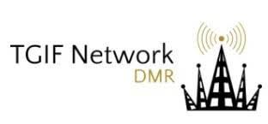

What is DMR?
Digital mobile radio (DMR) is a digital radio standard for voice and data transmission in non-public radio networks. It was created by the European Telecommunications Standards Institute (ETSI), and is designed to be low-cost and easy to use.
You will find DMR on what we affectionately call Cheap Chinese Radios. Baofeng Retevis RT3S, Tyt, and Anytone make radios that support DMR.
The common DMR networks are BrandMeister and TGIF. Others are made all the time.
https://brandmeister.network/?page=talkgroups
https://tgif.network/talkgroups.php

Slide 10

What is YSF?
System Fusion is Yaesu’s implementation of Digital Amateur Radio, utilising C4FM 4-level FSK Technology to transmit digital voice and data over the Amateur radio bands.

Slide 11
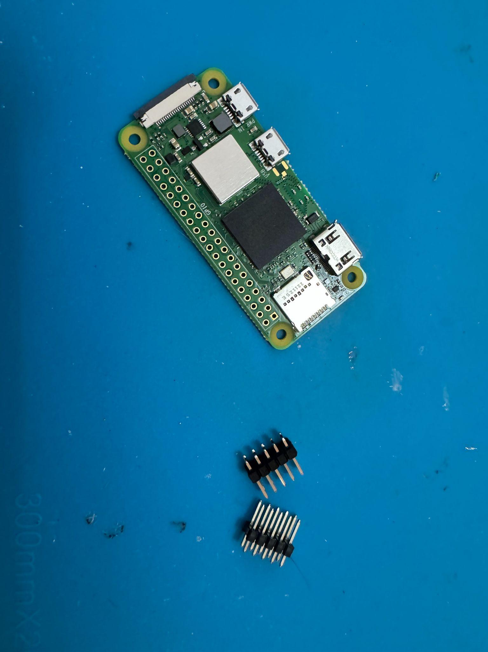
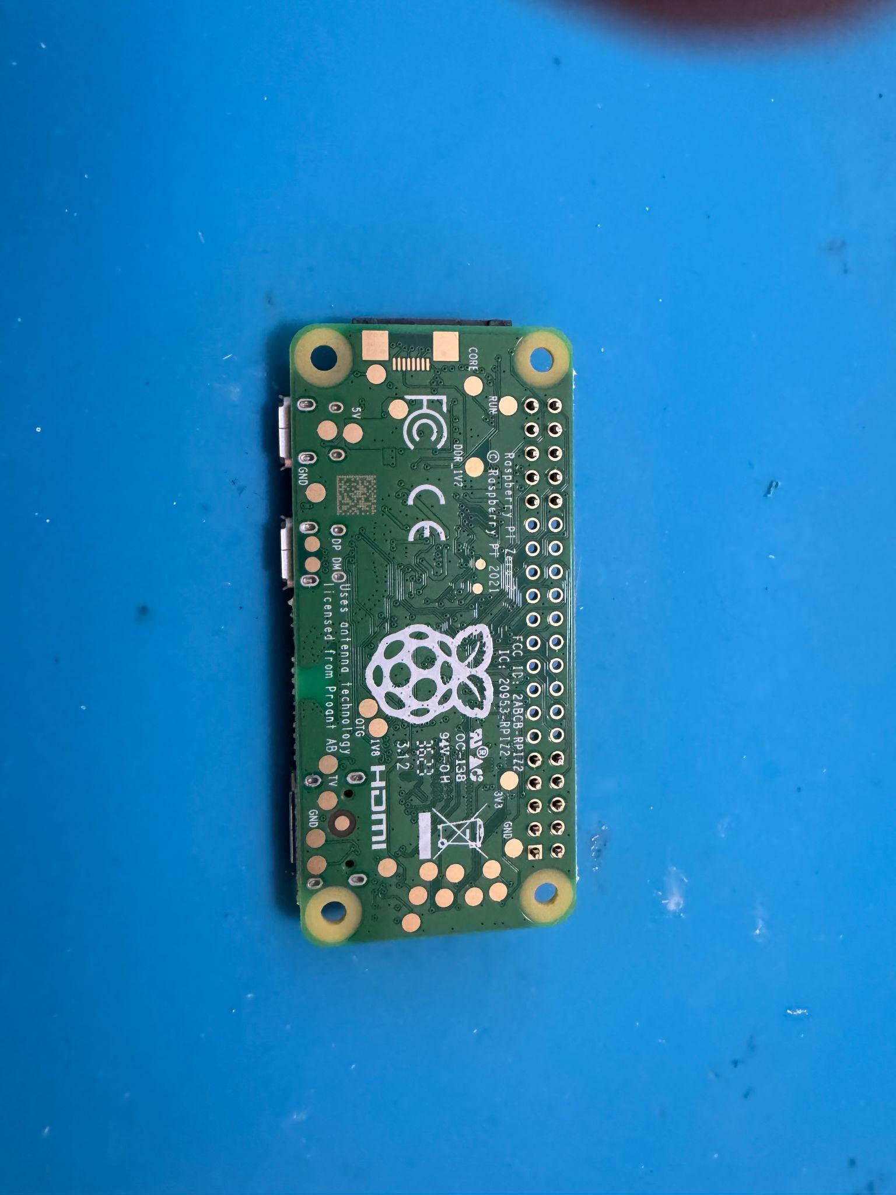
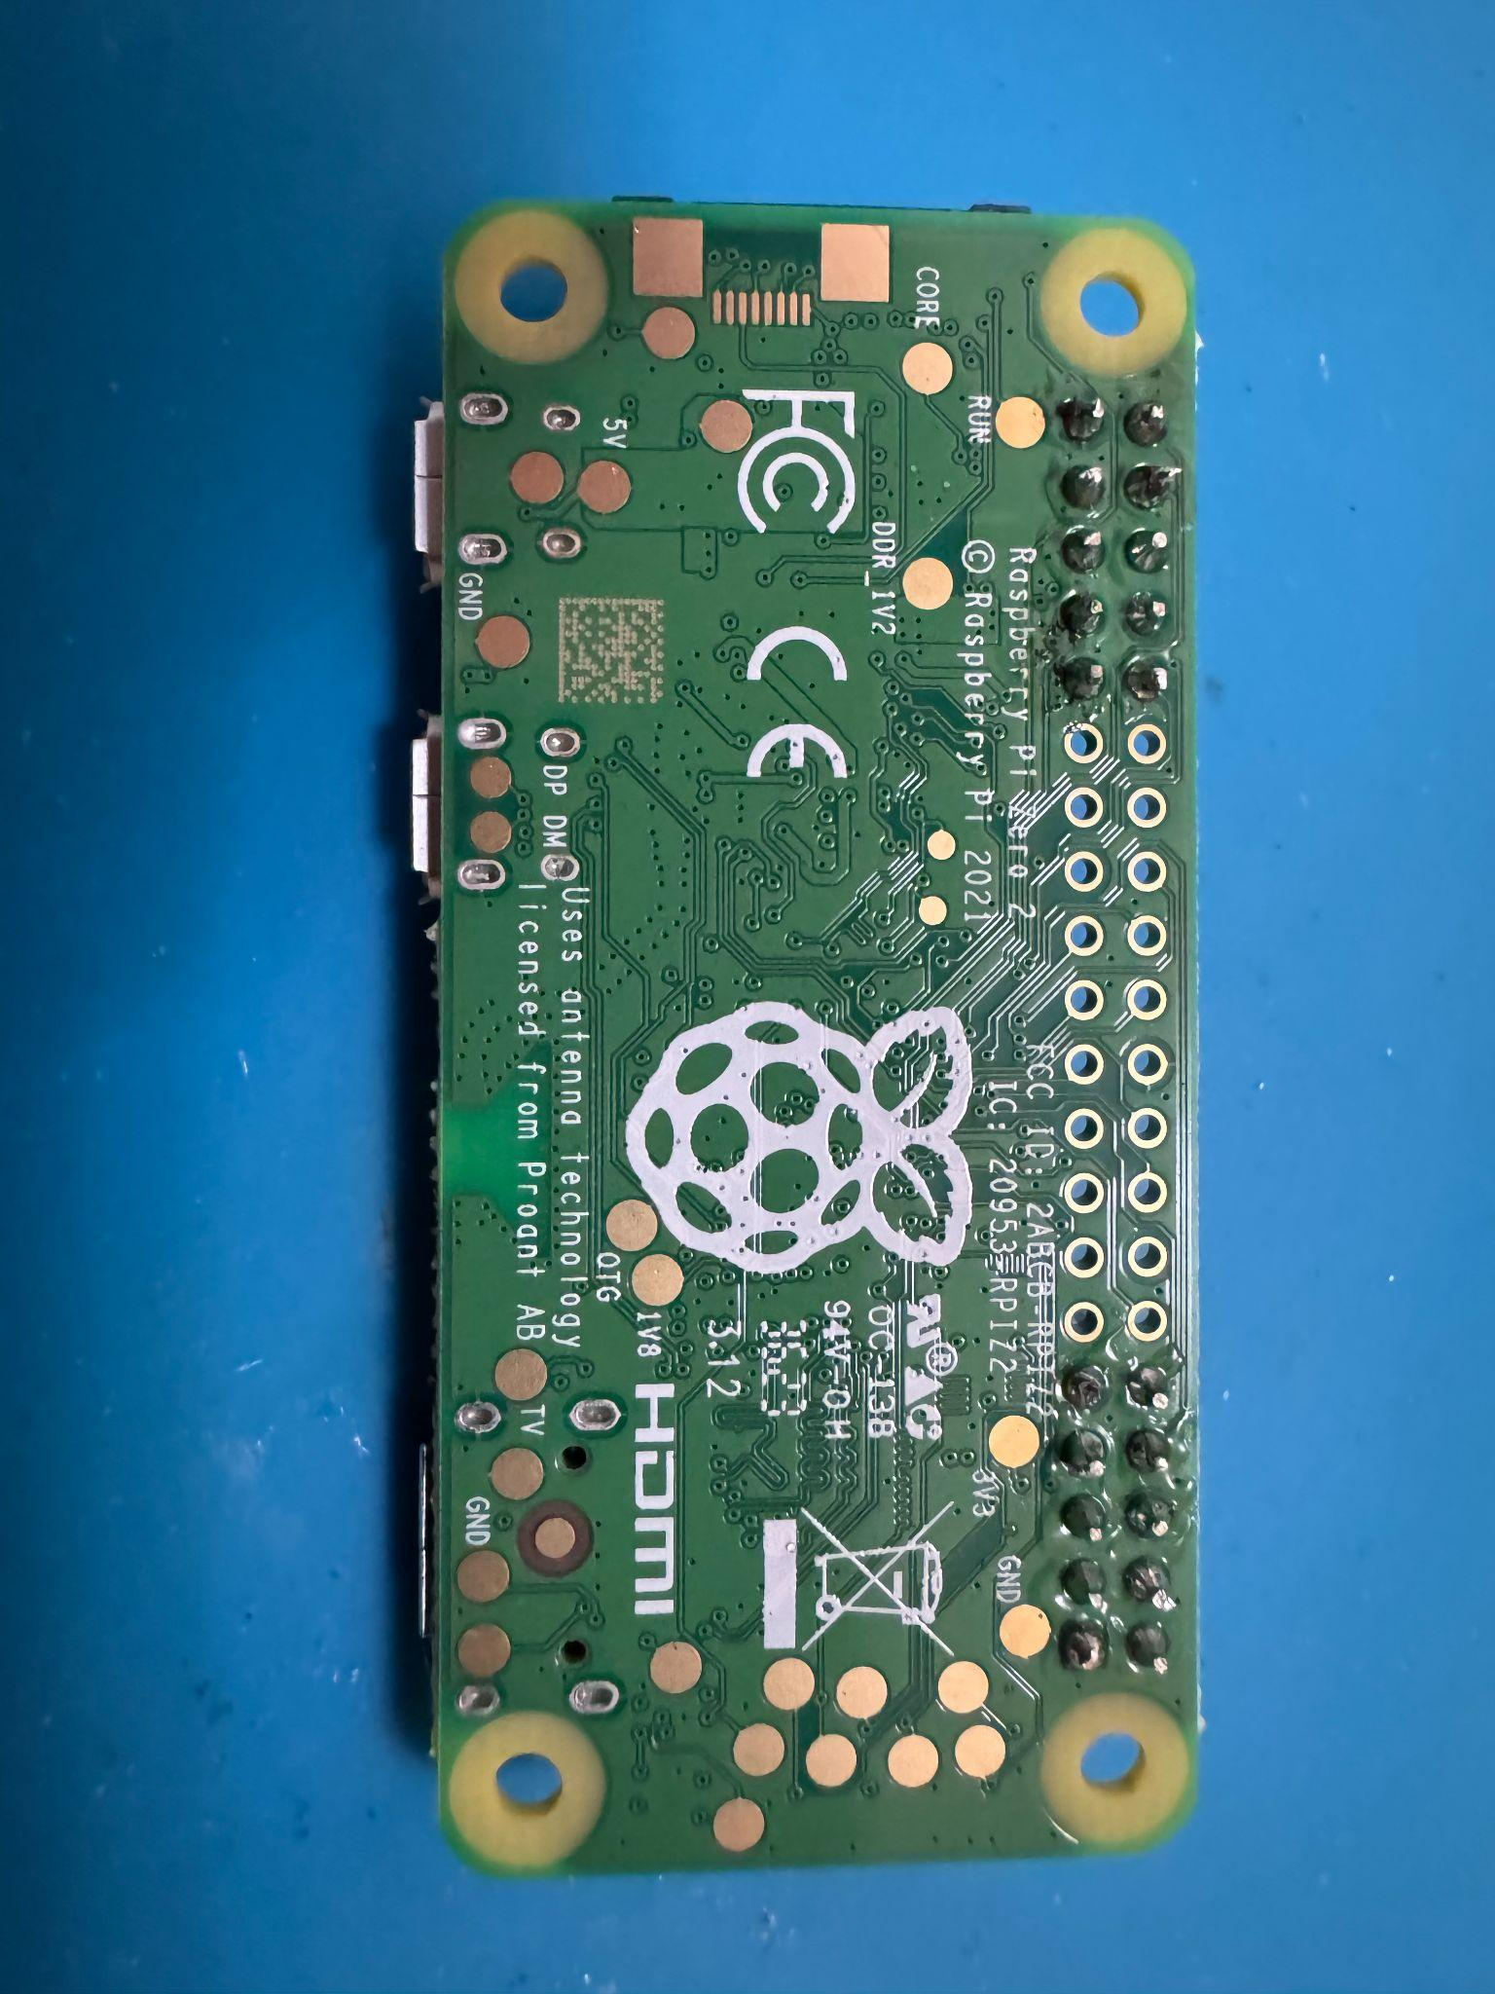
Soldering the Raspberry Pi Zero 2W

Slide 12

Here’s One I Prepared Earlier

Slide 13
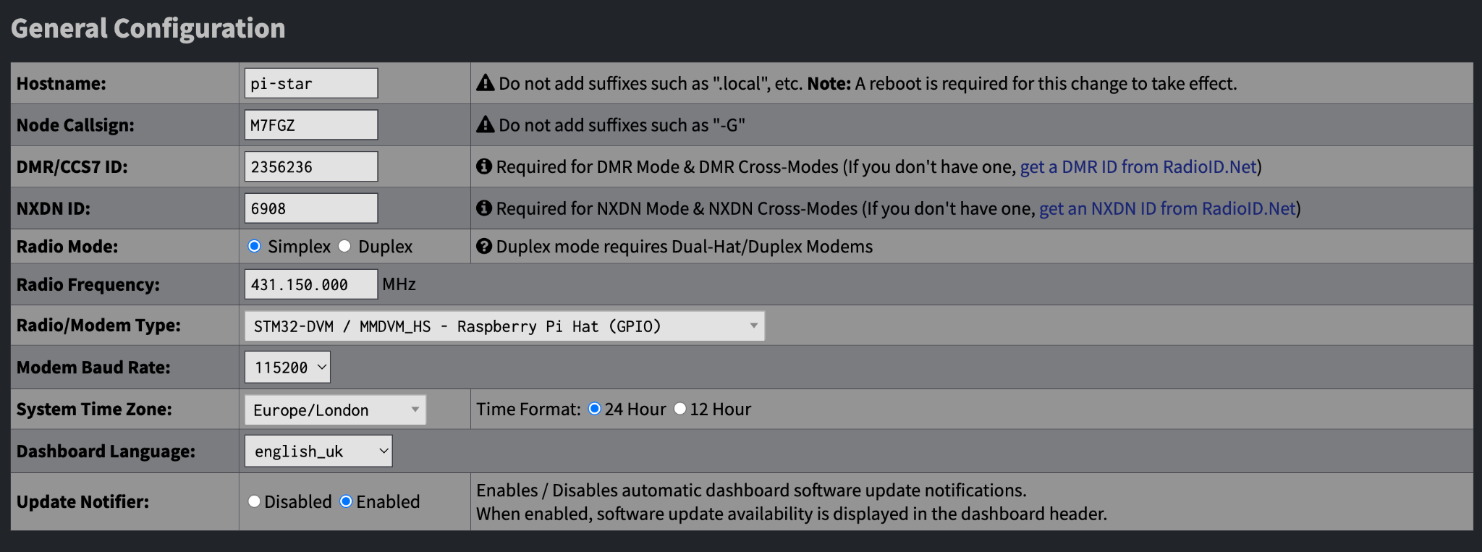
Initial Configuration

Slide 14
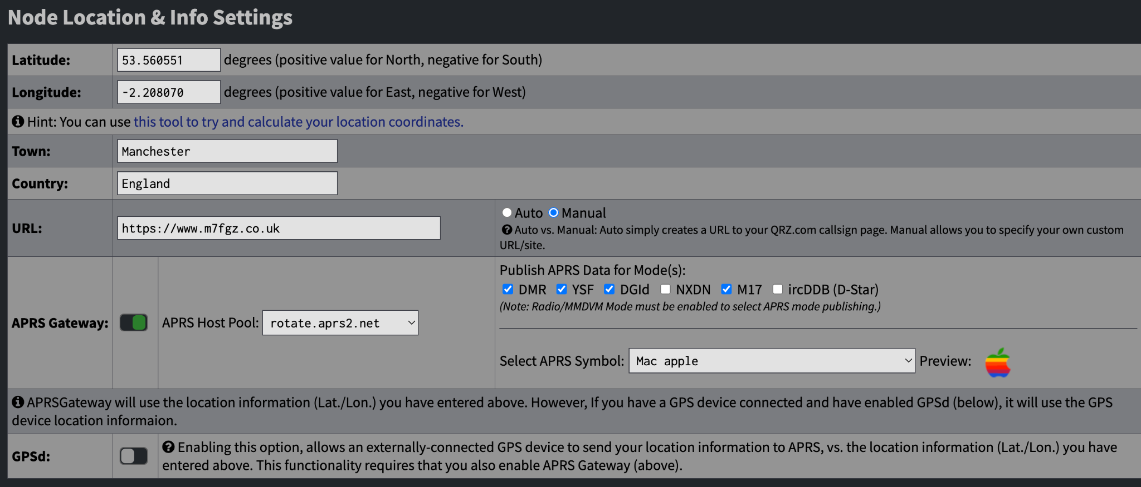
Node Location & Info Settings

Slide 15
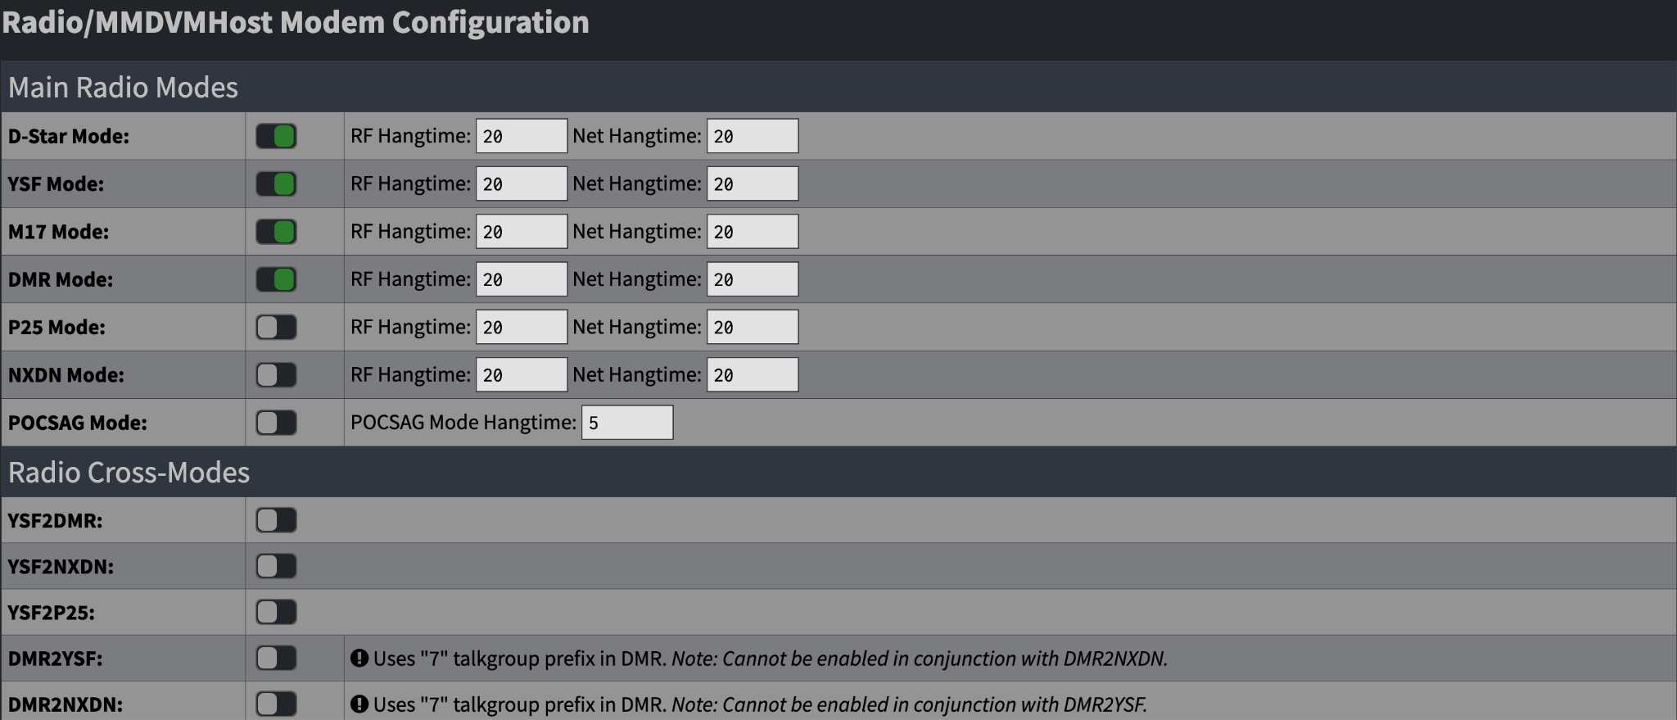
Radio/MMDVM Host Configuration

Slide 16
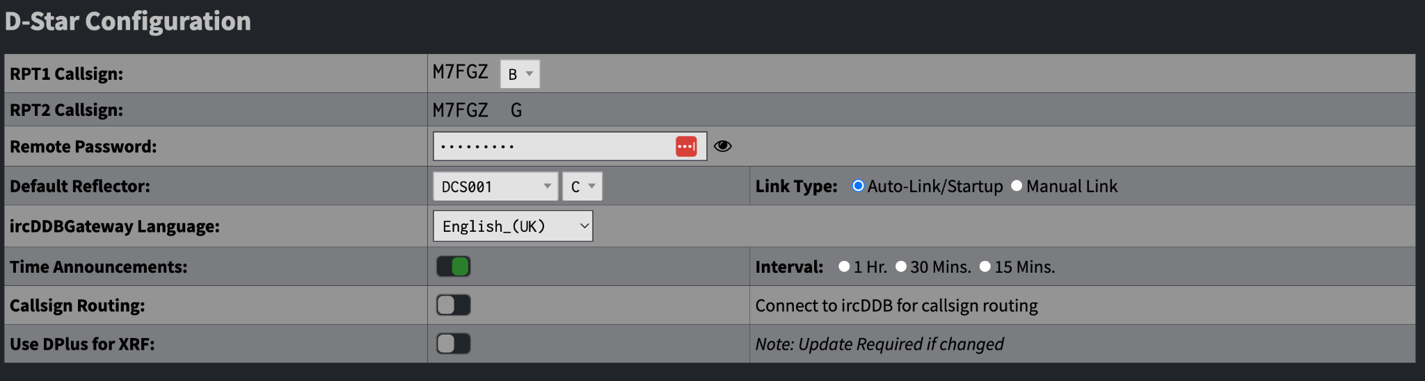
D-Star Configuration

Slide 17
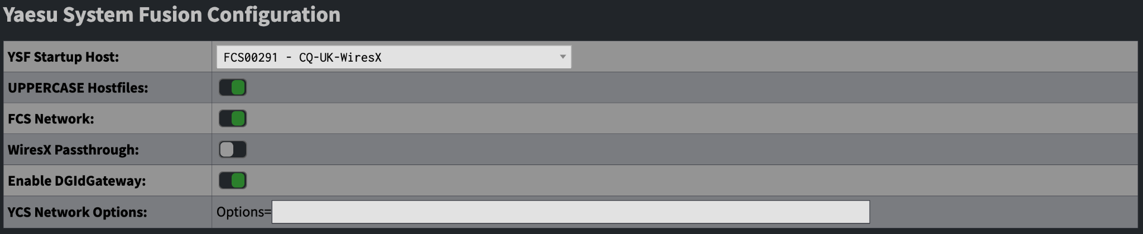
YSF Configuration

Slide 18
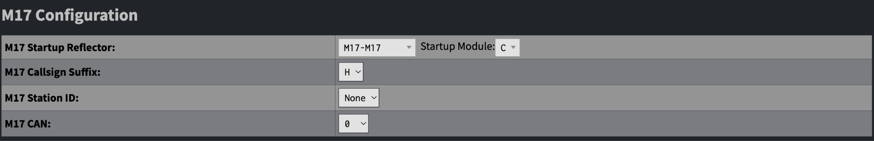
M17 Configuration

Slide 19
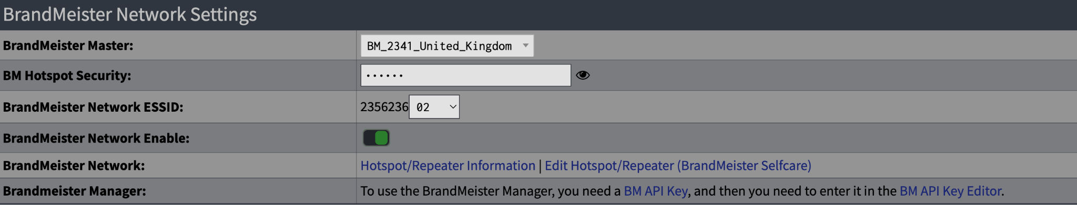

DMR / BrandMeister

Slide 20
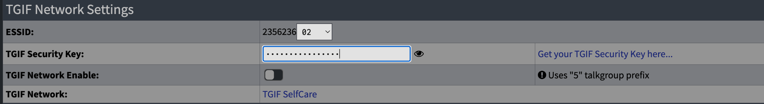
DMR / TGIF

Slide 21
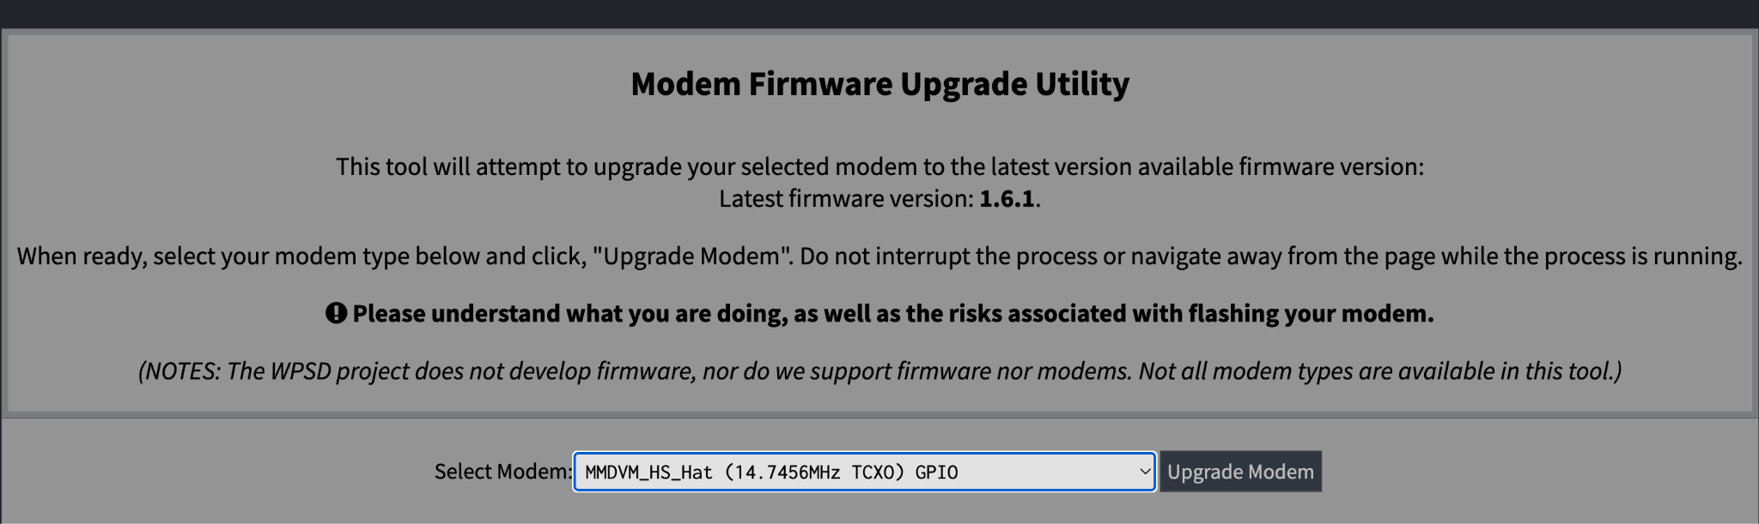
Modem Upgrade
Advanced > Tools > Modem Firmware Upgrade

Slide 22
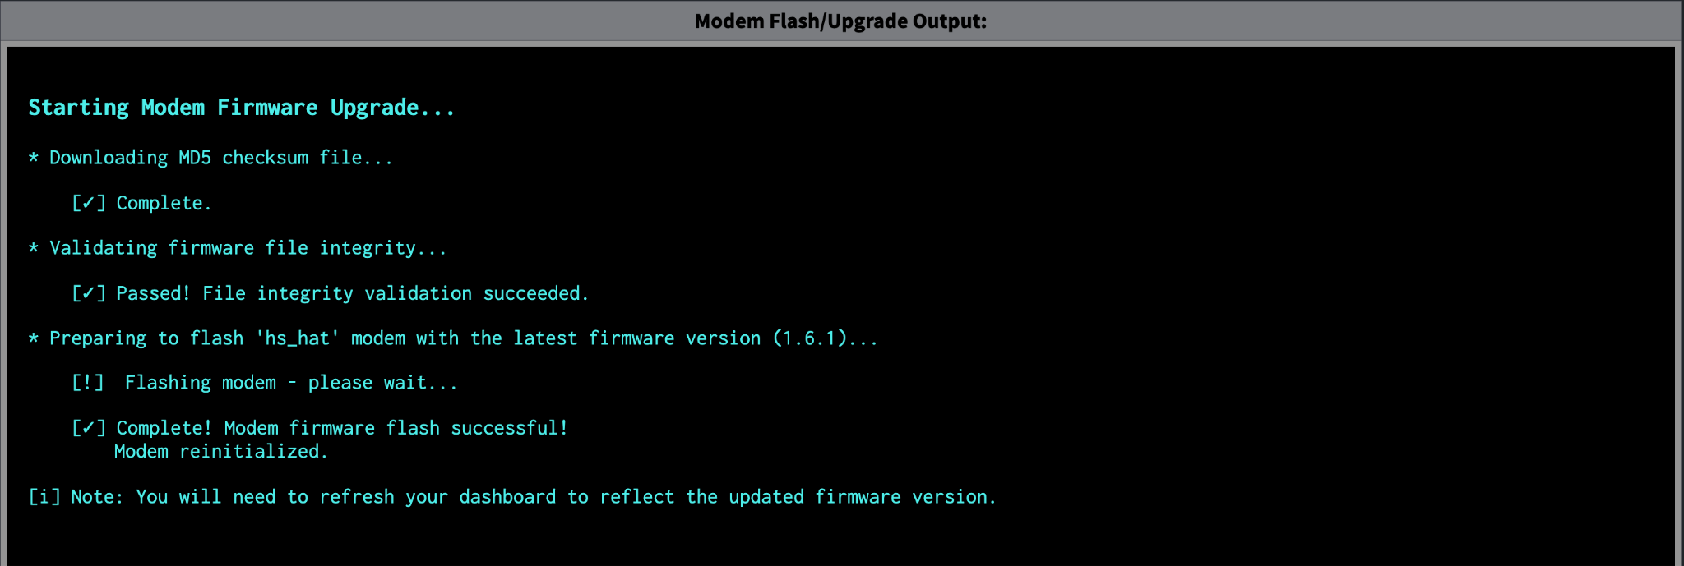
Modem Upgrading

Slide 23

Questions?

